Slide 1
Life cycle assessment using a suite of open-source python tools
ET Seminar / 2022-11-08
Elias Azzi

Slide 2
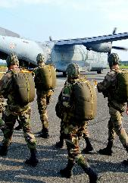
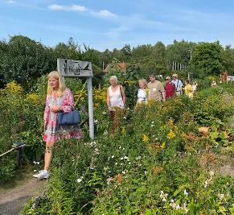





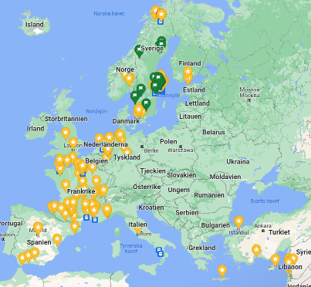

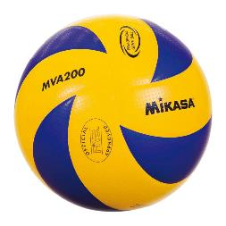

About
Husby Gård Koloniförening

Slide 3
Agenda
Part 1 – Overview of python tools for industrial ecology & LCA
Part 2 – Examples of how we’ve used brightway
a. brightway: On-farm energy modelling coupled to LCA
b. brightway & odym: classic product LCAs & dynamic material flow analysis
c. lca_algebraic: parametrized models, global sensitivity analysis, decision trees
d. bw_temporalis: time-dependent LCA / straw biochar
e. bw_widgets: interactive LCA results for project website
Part 3 – Questions / Tutorials / Demo / Getting started

Slide 4
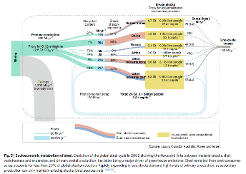
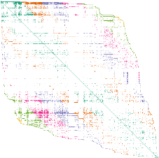
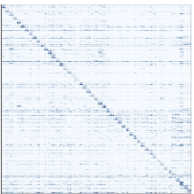
Industrial Ecology’s 3 main methods
MFA
Material flow analysis
LCA
Life cycle assessment
IOA
Input-output analysis with socio-environmental accounts
All three methods are based on:
Physics law: mass and energy conservation
Accounting theory: linear algebra, supply and use tables, bi-partite directed graphs, allocation and constructs theory
Historically,
Methods developed separately. Now, unified accounting theory exists (Pauliuk, 2015)
Methods were static. Today, dynamic and spatially-explicit variants exist
Notes:
[def][data requirements, in practice][derivates]

Slide 5
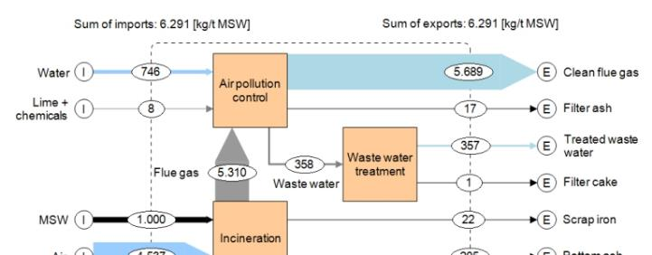
Historic tools & software – for MFA
Excel, Matlab, and similar
STAN https://www.stan2web.net/ (free)

Slide 6
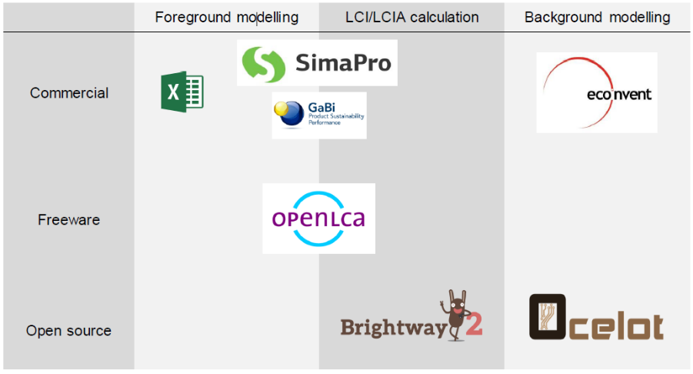





Historic tools & software – for LCA
Older… nice but not so flexible, and not free
Newer… flexible, and open-source
CC: Joyce P.J.

Slide 7
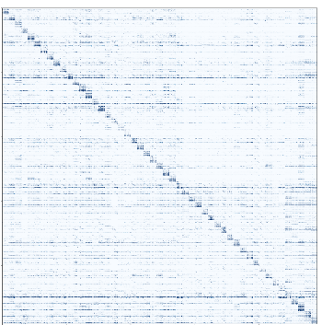
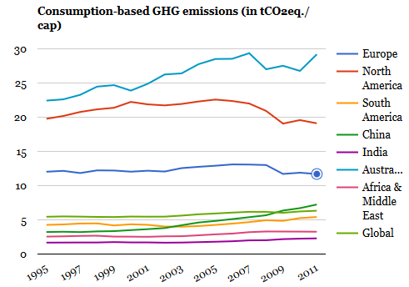
Historic tools & software – for IOA
Excel, Matlab, and similar
Custom code because it is mostly used at the research level or for national statistics, by few people around the globe.
© Exiobase, 2018 https://environmentalfootprints.org/

Slide 8
Limitations of classic tools
Flexibility of modelling
e.g. in SimaPro you can’t do time-dependent LCA, or programmatically edit the entire background database to make scenarios
Open-source & reproducibility & additivity of research
e.g. increasing requirements of modelling studies to be reproducible, data to be shared, science to be open-source
Research community is aware of it!
Pauliuk et al. 2015

Slide 9




A community effort to change things…
Several people, simultaneously, at different institutions…
https://github.com/cmutel
Bernhard Steubing https://github.com/bsteubing
https://github.com/stefanpauliuk
https://github.com/konstantinstadler
Many more contributors in each project and extensions…
Notes:
[Chris]
As part of his PhD, developed alone a python framework for LCA called brightway.
V0 launched back in 20xx. Now launching version 3, with a wide team of researchers in several countries.
Chris Mutel on the LCA side
Stephan Pauliuk > PhD in MFA, expert in dynamic aspects > used classical tools, > now released python one ODYM
Konstantin Stadler > as part of Exiobase project, legend in python packaging > IOA > packages for easy import of the data and manipulation
Berhard > GUI for bw2, based on side-money and own time > for his needs of modular LCA
(Raphael Jolivet > software dev, > algebraic tools)
A dashboard > were all is put together …

Slide 10
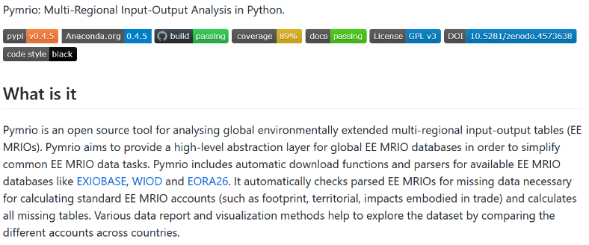
A community effort to change things…IOA
Several people, simultaneously, at different institutions…
https://github.com/konstantinstadler
https://pymrio.readthedocs.io/en/latest/
Notes:
Konstantin Stadler > as part of Exiobase project> IOA > packages for easy import of the data and manipulation
Example of 2 MSc students > starting their thesis with 0 knowledge in IOA > used pymrio > were able to do something straight away…
, legend in python packaging > making everything easy to install

Slide 11
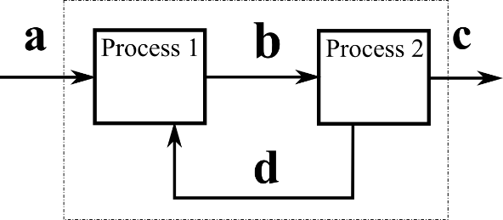
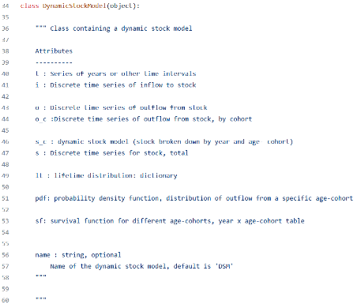
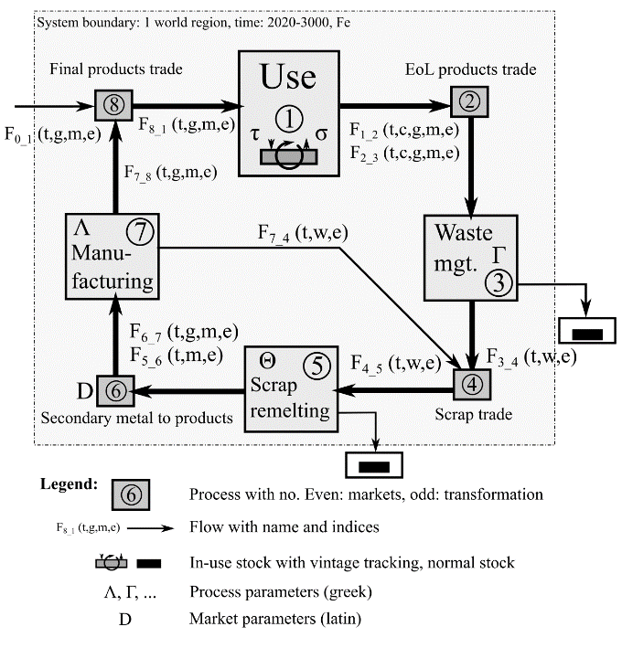
A community effort to change things… MFA
Several people, simultaneously, at different institutions…
https://github.com/stefanpauliuk
https://doi.org/10.1111/jiec.12952
Notes:
Stephan Pauliuk > PhD in MFA, expert in dynamic aspects > used classical tools, > now released python one ODYM
Konstantin Stadler > as part of Exiobase project, legend in python packaging > IOA > packages for easy import of the data and manipulation
Berhard > GUI for bw2, based on side-money and own time > for his needs of modular LCA
(Raphael Jolivet > software dev, > algebraic tools)
A dashboard > were all is put together …

Slide 12


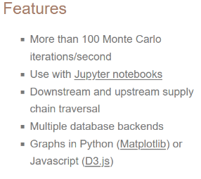
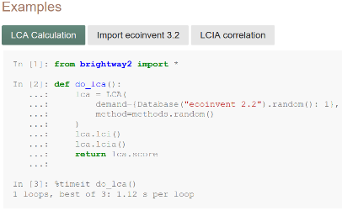
A community effort to change things… LCA
Several people, simultaneously, at different institutions…
https://github.com/cmutel
https://doi.org/10.21105/joss.00236
Notes:
[Chris]
As part of his postdoc work, developed alone a python framework for LCA called brightway.
V0 launched back in 2012. Now launching version 3, with a wide team of researchers in several countries.
Brightway2 is a open source framework for life cycle assessment (LCA). It doesn’t try to replace software like SimaPro or OpenLCA, but rather to offer new possibilities to those who want to break the limits of conventional LCA. So it's not for everyone, and you will need to invest some time learning about Python to use Brightway2. Basically, this is the framework for you if your project lies at the intersection of LCA and your imagination.

Slide 13
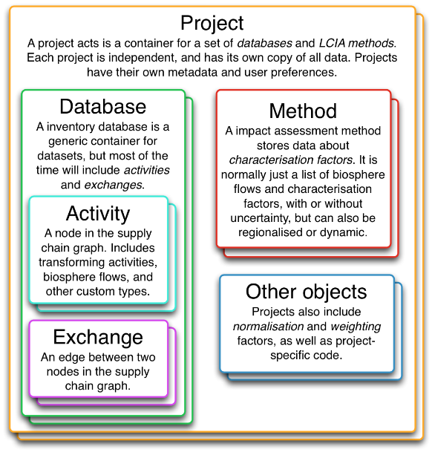
bw2 in short
Free & open-source
In development since 2012
Design goals were:
Freedom of data structure
Projects as self-contained objects
Easy data manipulation
Fast LCA calculations

Slide 14
From bw2 to bw25
bw2
Brightway2 is a open source framework for life cycle assessment (LCA). It doesn’t try to replace software like SimaPro or OpenLCA, but rather to offer new possibilities to those who want to break the limits of conventional LCA. Basically, this is the framework for you if your project lies at the intersection of LCA and your imagination.
bw2.5
Brightway 2.5 is the next generation of the Brightway2 framework for life cycle assessment. It provides new capabilities for cloud computing and model interaction, with the use of a new processed data library and a separation between the calculation library and a library for matrix construction and manipulation.
e.g. ever dreamt of programatically editing ecoinvent using future IPCC scenarios?

Slide 15
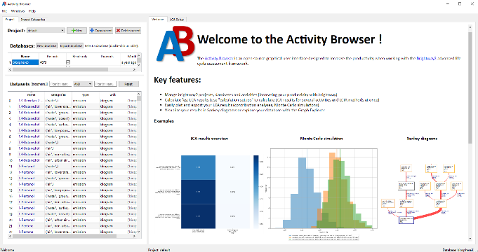
A community effort to change things… LCA
Several people, simultaneously, at different institutions…
Bernhard Steubing https://github.com/bsteubing
https://doi.org/10.1016/j.simpa.2019.100012
Notes:
[Bernhard]
Chris, it’s nice to do LCA with code, but sometimes, we need a GUI. So, he made one.
Today, I would say its faster than SimaPro, and has 90% of the functionalities of SimaPro.
Plus – you can develop your project in both code, and in the GUI, fully compatible!
Now, team of 5 persons developing it further.
The activity browser is an open source software for Life Cycle Assessment (LCA) that builds on top of the Brightway2 LCA framework.
Stephan Pauliuk > PhD in MFA, expert in dynamic aspects > used classical tools, > now released python one ODYM
Konstantin Stadler > as part of Exiobase project, legend in python packaging > IOA > packages for easy import of the data and manipulation
Berhard > GUI for bw2, based on side-money and own time > for his needs of modular LCA
(Raphael Jolivet > software dev, > algebraic tools)
A dashboard > were all is put together …

Slide 16
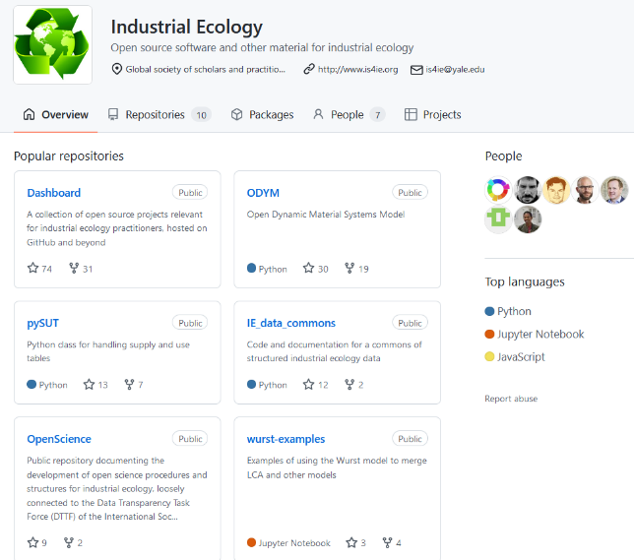
Industrial Ecology Dashboard
https://github.com/IndEcol/Dashboard
My favourites:
LCA
https://brightway.dev/
https://github.com/brightway-lca
https://github.com/LCA-ActivityBrowser/activity-browser
https://github.com/oie-mines-paristech/lca_algebraic
tLCA
https://github.com/brightway-lca/temporalis
dMFA
https://github.com/IndEcol/ODYM
IOA
https://github.com/konstantinstadler/pymrio

Slide 17
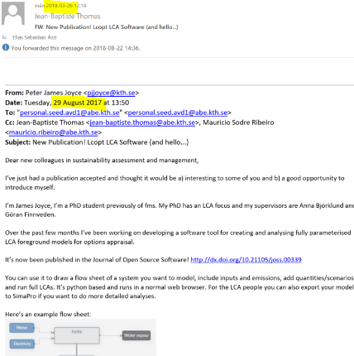
My journey in all this?
An email forwarded back in March 2018…
Lots of learning, trial and errors
Done:
5+ LCA studies using bw2
Supervised a handful of master theses
Used in 1 course
Mainly a re-user of existing code
Combining tools together, e.g. energy models & LCA models
To some extent:
Developing new functions, e.g. contribution analysis & plotting
identifying/fixing bugs/writing issues/participation in conference

Slide 18
Part 2 – Examples of how we’ve used brightway
a. brightway: On-farm energy modelling coupled to LCA
https://doi.org/10.1016/j.jclepro.2020.124873 https://github.com/ntropy-esa/P2_farm_biochar
b. brightway & odym: classic product LCAs & dynamic material flow analysis
https://doi.org/10.1007/s42773-022-00144-3 https://github.com/ntropy-esa/P5_uppsala
c. lca_algebraic: parametrized models, global sensitivity analysis, decision trees
https://doi.org/10.31223/X5ZK9C https://github.com/SLU-biochar/Bioenergy-CDR-LCA
d. bw_temporalis: time-dependent LCA / straw biochar
Mistra Food Futures – Report
e. bw_widgets: interactive LCA results for project website
https://github.com/SLU-biochar/bw2-widgets https://biochar.systems/modules/2-pyrolysis/
Notes:
WE = Cecilia, Shivesh, Lisa & more (MSc: Louise)

Slide 19
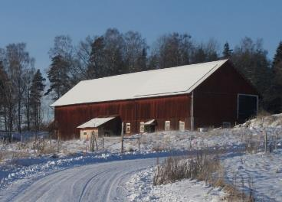
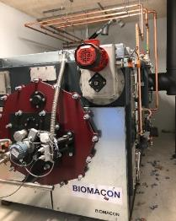
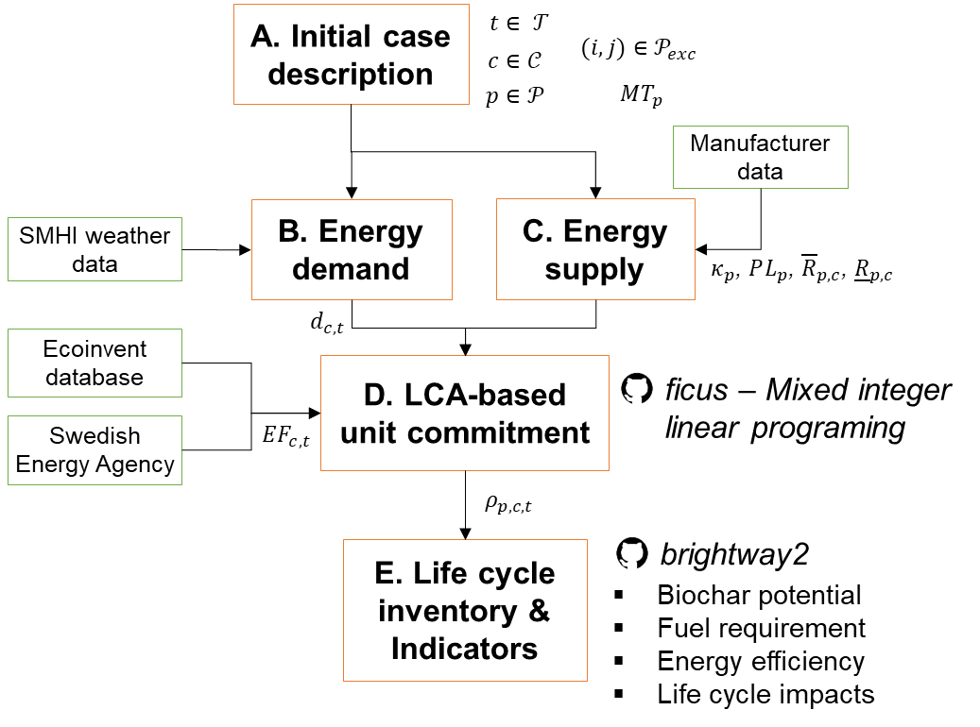
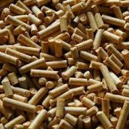
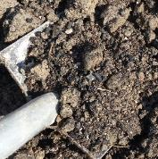
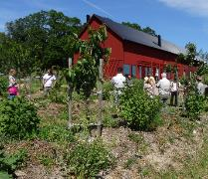
On-farm energy modelling coupled to LCA
Farm activities:
Organic grain production (12 ha)
Hotel, conference, and courses
Heating equipment:
50 kW pyrolysis
16 kW heat pump
Electrical heaters
In an energy-efficient system, what is a farmer’s biochar production potential?
What is the environmental performance of pyrolysis-heating compared with reference technologies?

Slide 20
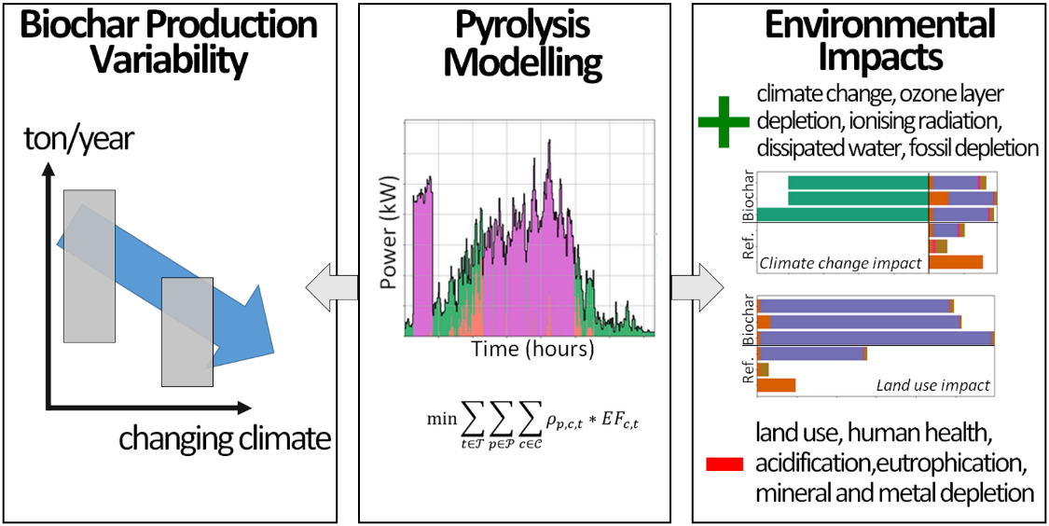
On-farm energy modelling coupled to LCA
https://doi.org/10.1016/j.jclepro.2020.124873 ; https://github.com/ntropy-esa/P2_farm_biochar
Notes:
>> I see many uses cases here in the department, for the teams making some optimisation models, or engineering systems which requires it’s own modelling: little effort, add some LCA dimension.

Slide 21
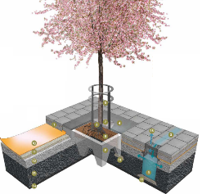
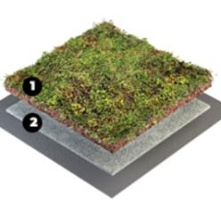
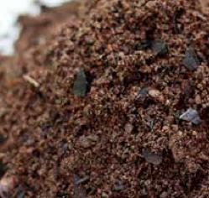
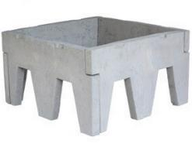
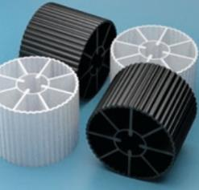
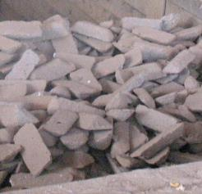
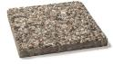
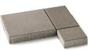
Many product LCAs & dynamic material flow analysis
1. Tree in hard-surface area
2. Extensive green roof
3. Planting soil
Different technology readiness levels
For each product, several designs, formulations, and dimensions may exist
Pig iron – no carbon dioxide removal, but fossil fuel substitution (benchmark)
© Stockholm city
© VegTech AB
© Hasselfors AB
4. Concrete elements
5. Biofilm carrier
6. Pig iron (for steel)
© StockholmsTreePits Co., St Eriks AB
© Wikipedia Commons
© Wikipedia Commons
Notes:
With all these questions in mind, we decided to look at…

Slide 22
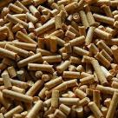
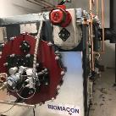
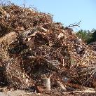
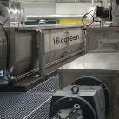
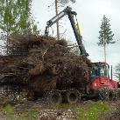
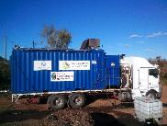
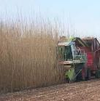
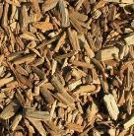
Many product LCAs & dynamic material flow analysis
4 biomass types
3 reactor types, with pre-drying
2 energy systems
Current Swedish average energy mix
Fossil energy mix, based on natural gas heat and power, and fossil diesel
Wood pellets – WP
from sawmill residues,
alt. combusted for
district heat
Syngas-heated reactor – S
representative of Pyreg
or BioMaCon units
Garden waste – GW
from urban areas,
alt. combusted for
district heat
Electricity-heated reactor – E
representative of BioGreen units
Logging residues – LR
from SE forests,
alt. left to decay
in forest
© BioGreen
Mobile reactor – M
representative of Charmaker MPP
Willow chips – WL
grown on fallow land,
alt. not cultivated land
© EarthSystems
© FAO, P. ARONSSON

Slide 23
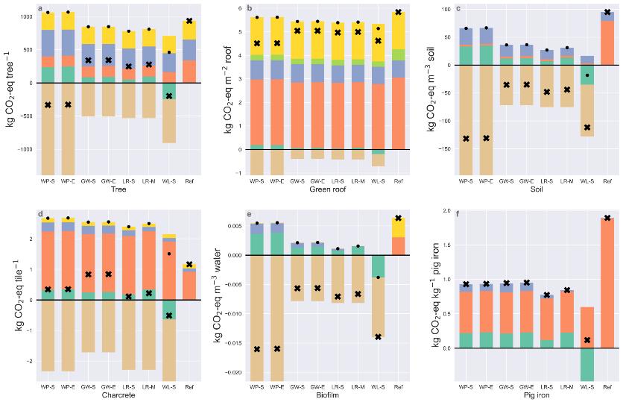
Many product LCAs & dynamic material flow analysis
✖ Net score ● Net score without C-sink

Slide 24
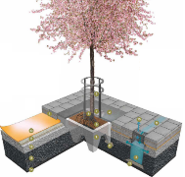
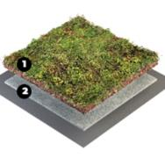
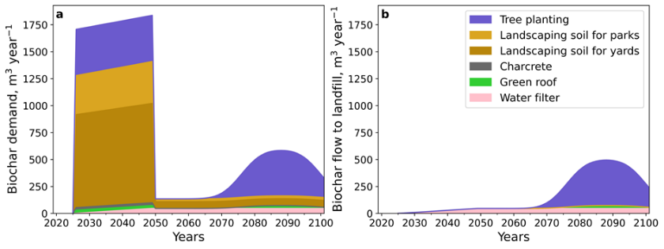
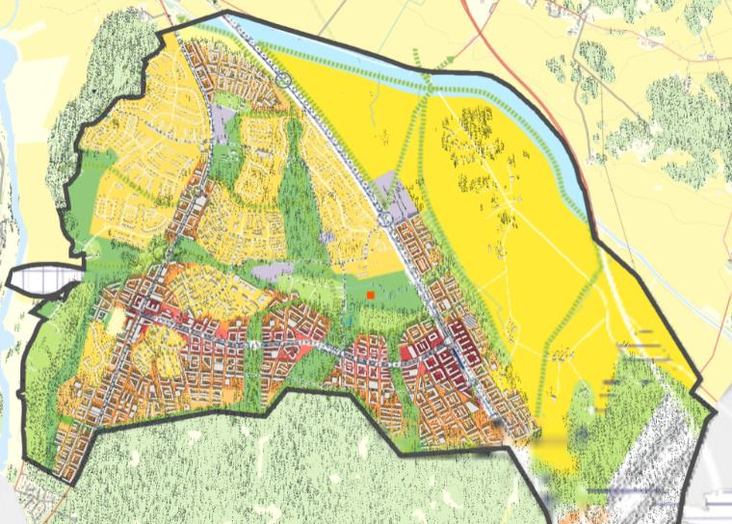
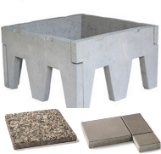


Many product LCAs & dynamic material flow analysis
Biochar
demand
Biochar waste
flow
Takeaways
About 2000 m³ year⁻¹ of biochar for 25 years (57 000 inhabitants)
C sink is up to 1/10th of the emissions from building construction
Notes:
>>> other work with SFA /
>>> ODYM > could be very useful here for MistraFoodFutures

Slide 25


Parametrized LCA, with GSA and DTs
Using a new add-on to brightway2:
lca_algebraic, released in 2021
The theory:
In practice:
You develop your LCA model in brightway2 or the activity-browser, as usual, defining any parameters and equations you like
With lca_algebraic, you convert your whole model into an algebraic equation, which is super-super-super fast to compute.
Notes:
>>> really like parametrized models; parameters bring physics & uncertainty estimates into your models; but also “generality”
>>> analysis of complexity of the outcomes can be done using DTs – a nice area!
GSA = Global Sensitivity Analysis
DTs = Decision Trees

Slide 26


Parametrized LCA, with GSA and DTs
Lisa’s 1st paper & MSc thesis used these tools.

Slide 27



Parametrized LCA, with GSA and DTs
I love decision trees to analyse complex models & identify “general rules” using entropy!
If $BC_{100}>50\%$
False
True
CHP “wins” in 100% of cases
Biochar “wins” in 90% of cases
If $α>80\%$
Stop
False
True
CHP “wins” in 100% of cases
Biochar “wins” in 100% of cases
Stop
Stop

Slide 28



Time dependent LCA for straw management
Notes:
>>> time in LCA: has always been neglected in LCA, by choice/construction
>>> time in LCA: can be both in the inventory foreground model; inventory background model; and in the LCIA
>>> here, at the dpt some good exp with LCIA & to some extend timed foreground inventories when it comes to biogenic C flows
>>> bw2 has an extension for that, called temporalis

Slide 29

Interactive LCA results for project website
bw2widgets / Convert a simple parametrized brightway2 model to an interactive javascript widget, for simple inclusion in a website / based on lca_algebraic & contribution analysis & d3.js
https://github.com/SLU-biochar/bw2-widgets https://biochar.systems/modules/2-pyrolysis/

Slide 30
Part 3 – Questions / Tutorials / Demo / Getting started
Getting started in 1 slide
Read docs at https://2.docs.brightway.dev/intro.html
Install brightway2 with instructions here https://2.docs.brightway.dev/installation.html
Install the dev version of the activity-browser here https://github.com/LCA-ActivityBrowser/activity-browser#development-version
Explore example Jupyter Notebooks https://2.docs.brightway.dev/notebooks.html#example-notebooks ; Watch YouTube videos https://www.youtube.com/channel/UCsyySKrzEMsRFsWW1Oz-6aA
Register to the brightway mailing groups & be-aware of upcoming courses/conferences/releases https://brightway.groups.io/g/development https://2022.brightcon.link/ https://2021.brightcon.link/ https://2020.brightcon.link/
Explore on Github https://github.com/brightway-lca
Talk to your colleagues! + Autumn School https://github.com/Depart-de-Sentier/Autumn-School-2022

